Slide 1




AT82.02
Data Modeling and Management
Unit 1-2: RDBMS
Chutiporn Anutariya (chuti at ait dot ac dot th)

Slide 2

Major parts of these slides on RDBMS are based on the slides prepared by José Machado, Paulo Novais and Regina Sousa, University of Minho
Under the DS&AI Project

Slide 3

RELATIONAL DATABASE MANAGEMENT SYSTEMS (RDBMS)
Database
Relational Database
Relational Database Management System
A relational database management system (RDBMS) is a program that allows you to create, update, and administer a relational database. Most relational database management systems use the SQL language to access the database.
A relational database is a type of database. It uses a structure that allows us to identify and access data in relation to another piece of data in the database. Often, data in a relational database is organized into tables.
A database is a set of data stored in a computer. This data is usually structured in a way that makes the data easily accessible.

Slide 4
RDBMS VS. DBMS
An RDBMS is a type of database management system (DBMS) that stores data in a table which connects related data elements.
A RDBMS includes functions that maintain data security, accuracy, integrity and consistency;
The data is stored in table form;
Supports multiple users;
supports client-server architecture
It has high software and hardware requirements
Keys and indexes do not allow data redundancy.
It does not apply any security protocol with respect to data manipulation.
The DBMS stores the data as an archive;
Supports only one user;
Does not support client-server architecture;
Requires few software and hardware requirements
It does not take into account the concept of standardization, leading to redundancy in data.

Slide 5
ADVANTAGES OF RELATIONAL DATABASE MANAGEMENT SYSTEMS
Data Structure
The table format is basic and easy to use and understand for database users. RDBMS allow data to be accessed via a native structure and organization of the data. Database queries can search each column for corresponding entries.
Maintenance
RDBMS have maintenance programs that provide administrators with tools to simply maintain, test, repair and back up the databases hosted on the system. Many of the features can be automized through the built-in automation in the RDBMS.
Network Access
RDBMS provide access to the database through a server daemon, a dedicated software program that listens for requests on a network and allows database clients to connect to and use the database.

Slide 6
ADVANTAGES OF RELATIONAL DATABASE MANAGEMENT SYSTEMS
Multi-User Access
RDBMS allow several users to access a database synchronously. Built-in lock and transaction management features help users access data as it is being changed, prevent conflicts between two users who are updating data, and prevent users from accessing partially updated records.
Privileges
Authorization and privilege control features in an RDBMS allow the database administrator to restrict access to authorized users, and grant privileges to individual users based on the types of database tasks they need to perform. Authorization can be defined based on the remote client IP address in combination with user authorization, restricting access to specific external computer systems.
Language
RDBMSs support a generic language called "Structured Query Language" (SQL). The SQL syntax is simple, and the language uses standard English language keywords and phrasing, making it fairly intuitive and easy to learn. Many RDBMSs add non-SQL, database-specific keywords, functions and features to the SQL language.

Slide 7
POPULAR RELATIONAL DATABASE MANAGEMENT SYSTEMS
SQL
PostgreSQL
SQLite
Oracle
SQL Server

Slide 8
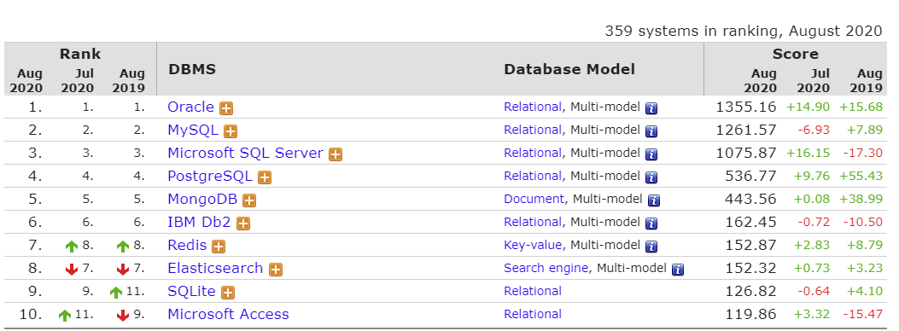
DB-Engines Ranking
https://db-engines.com/en/ranking

Slide 9
MySQL

Slide 10

MySQL
What is MySQL?
Why use MySQL?

Slide 11
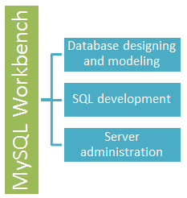
MySQL Workbench
An integrated development environment for MySQL server.
A Visual database designing and modeling access tool for MySQL server relational database.
Facilitates creation of new physical data models and modification of existing MySQL databases with reverse/forward engineering and change management functions.

Slide 12
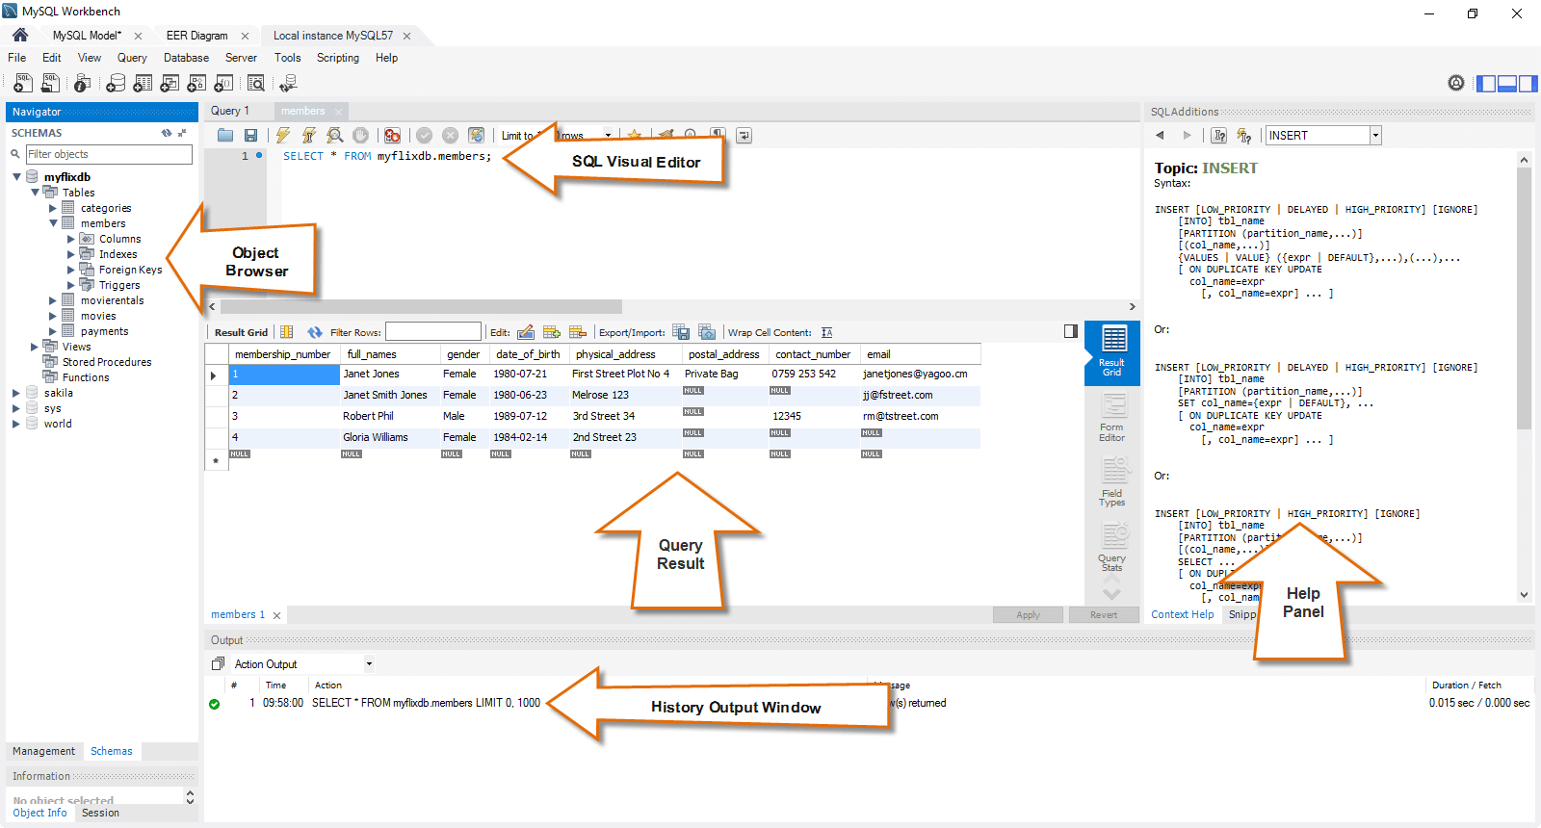
MySQL workbench - SQL development tool

Slide 13
MySQL workbench - Administration tool
User administration
Server configuration
Database backup and restorations
Server logs

Slide 14
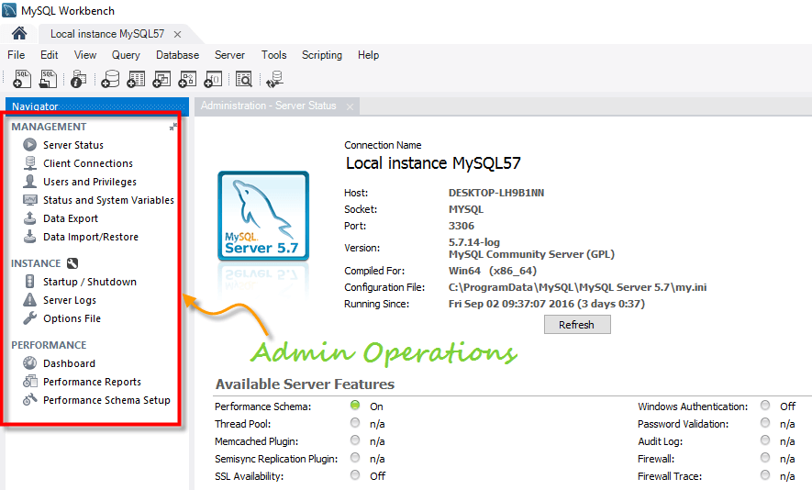
MySQL workbench - Administration tool

Slide 15
References
MySQL Workbench Tutorial & MySQL Introduction https://www.guru99.com/introduction-to-mysql-workbench.html
MySQL Tutorial https://www.guru99.com/mysql-tutorial.html

Slide 16

Thank you.
Exit Slip:
Discuss 3 important things / concepts we have learned today.

